Slide 1
KANBAN
By,
M M.Dharinisri
2022-7688

Slide 2
KANBAN
Kanban is a project management method that helps visualize tasks, while Scrum is a method that provides structure to the team and schedule.

Slide 3
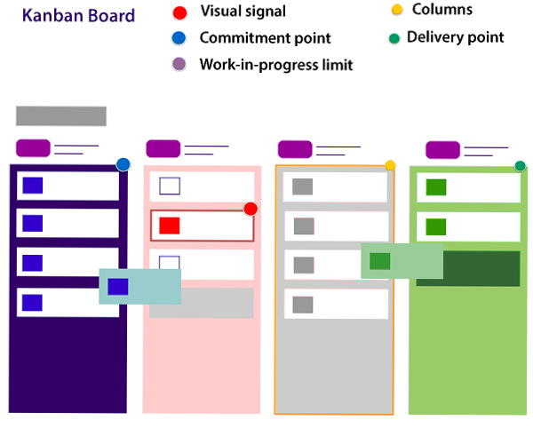

Slide 4
CHARACTERISTICS OF KANBAN.
Improvement in workflow
Limiting Work-In-Progress
Continuous Delivery
Pull Approach
Visual metrics

Slide 5
Distinguish Between Kanban & Scrum
S No. | Kanban | Scrum
1. | Planning, release, and process improvement can have separate cadences. | Iteration is timeboxed.
2. | For planning and process improvement, the lead time is used as the default metric. | For planning and process improvement, Velocity is used as the default metric.
3. | Cross-functional teams are optional. | Cross-functional teams prescribed.
4. | Project Tracking: CFD can be used to understand workflow progress. | Project Tracking: Burndown chart is prescribed.
5. | WIP limited directly (per workflow state). | WIP limited indirectly (per sprint).
6. | Can add new items whenever the WIP limit falls. | Cannot add items to ongoing iteration.

Slide 6
When to use Kanban
Kanban can be used in any domain, and it can be used very effectively in software development. Kanban project management helps in improving the efficiency of the team.
It is a pull-based system. Tasks are being pulled as soon as an individual is free.
Kanban should be used when you want to release your work at any time. It requires git branching, but it is doable.
Kanban should be used when you want to change the priorities on the fly. For that, all you need to do is to put this story on the top of the to-do queue.
It should be used when you want to visualize your work, and you want to see the progress of your tasks visually

Slide 7
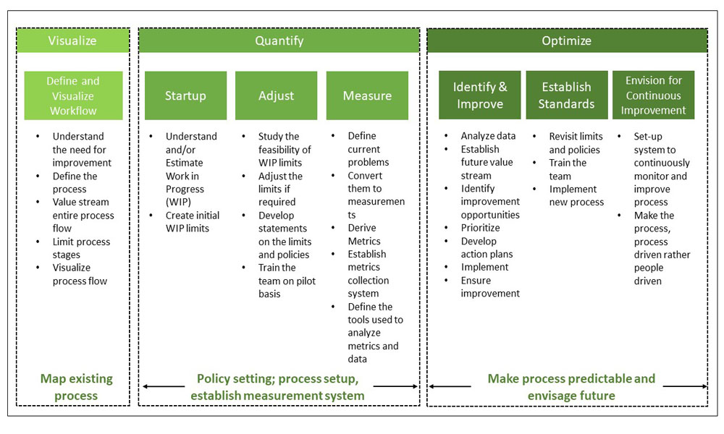
Kanban Approach

Slide 8
Kanban Workflow – How does Kanban Pull System Work
1. Visualize your Workflow:
Identify work stages and the work items.
Work items:
The max effort of 2 days to keep it short and moving.
Write work items on cards and stick them in columns, under corresponding work stages, based on system workflow – From left to right.
Workflow can be depicted physically or with a tool like Jira.
Sample Work stages:
Design, Development, Test, Production, Deployment, Done.
Each Stage can be split into- Ready and In Progress.
Initially, these two sub-stages may not be present.
Later they are introduced to check the waiting time in each stage

Slide 9
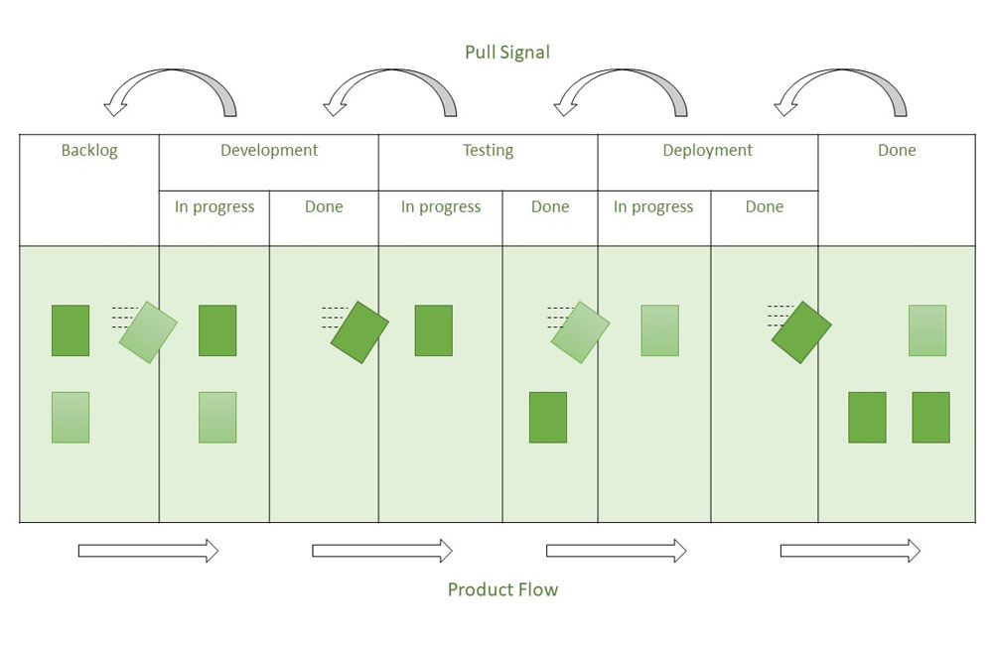
2. Establish a Pull System

Slide 10
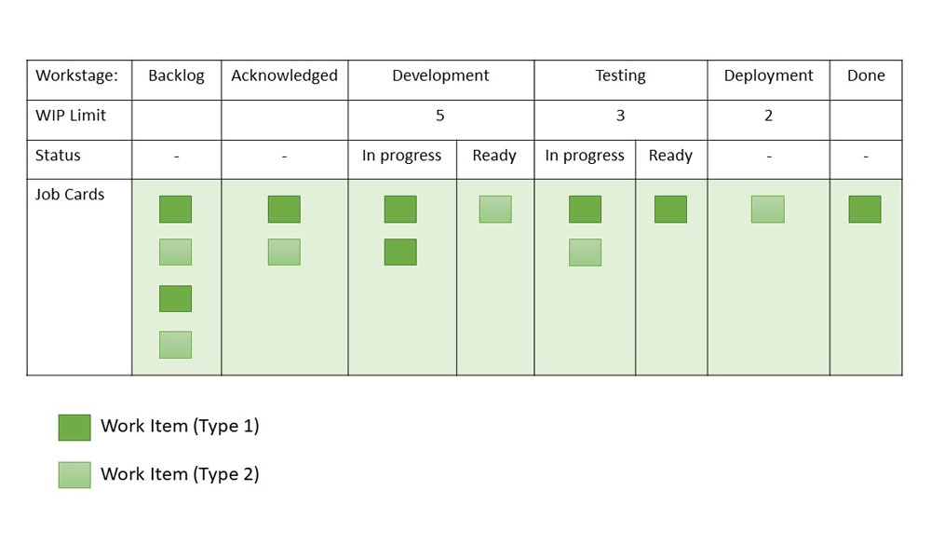
3. Limiting WIP:

Slide 11
KANBAN TOOLS
Kanban Tool
Kanbanery
LeanKit
JIRA Software
Earliz
Targetprocess

Slide 12
THANK YOU

